Slide 1
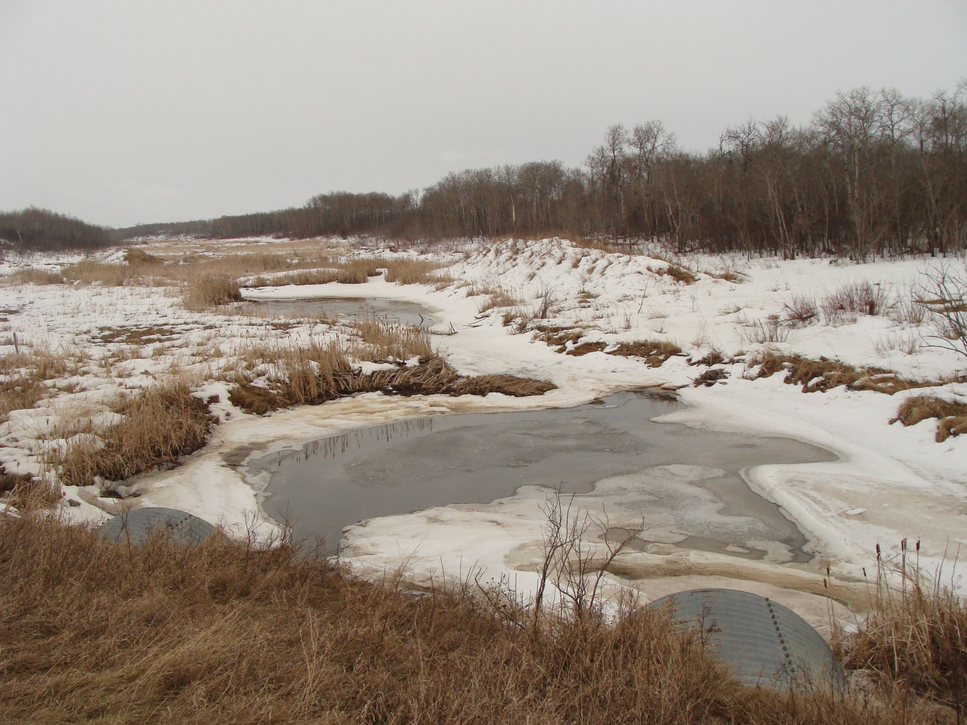


The Impacts of Wetland Loss in the Canadian Prairies
Pascal Badiou, Lyle Boychuck, and Bryan Page
Ducks Unlimited Canada
PPWB January 30, 2013

Slide 2
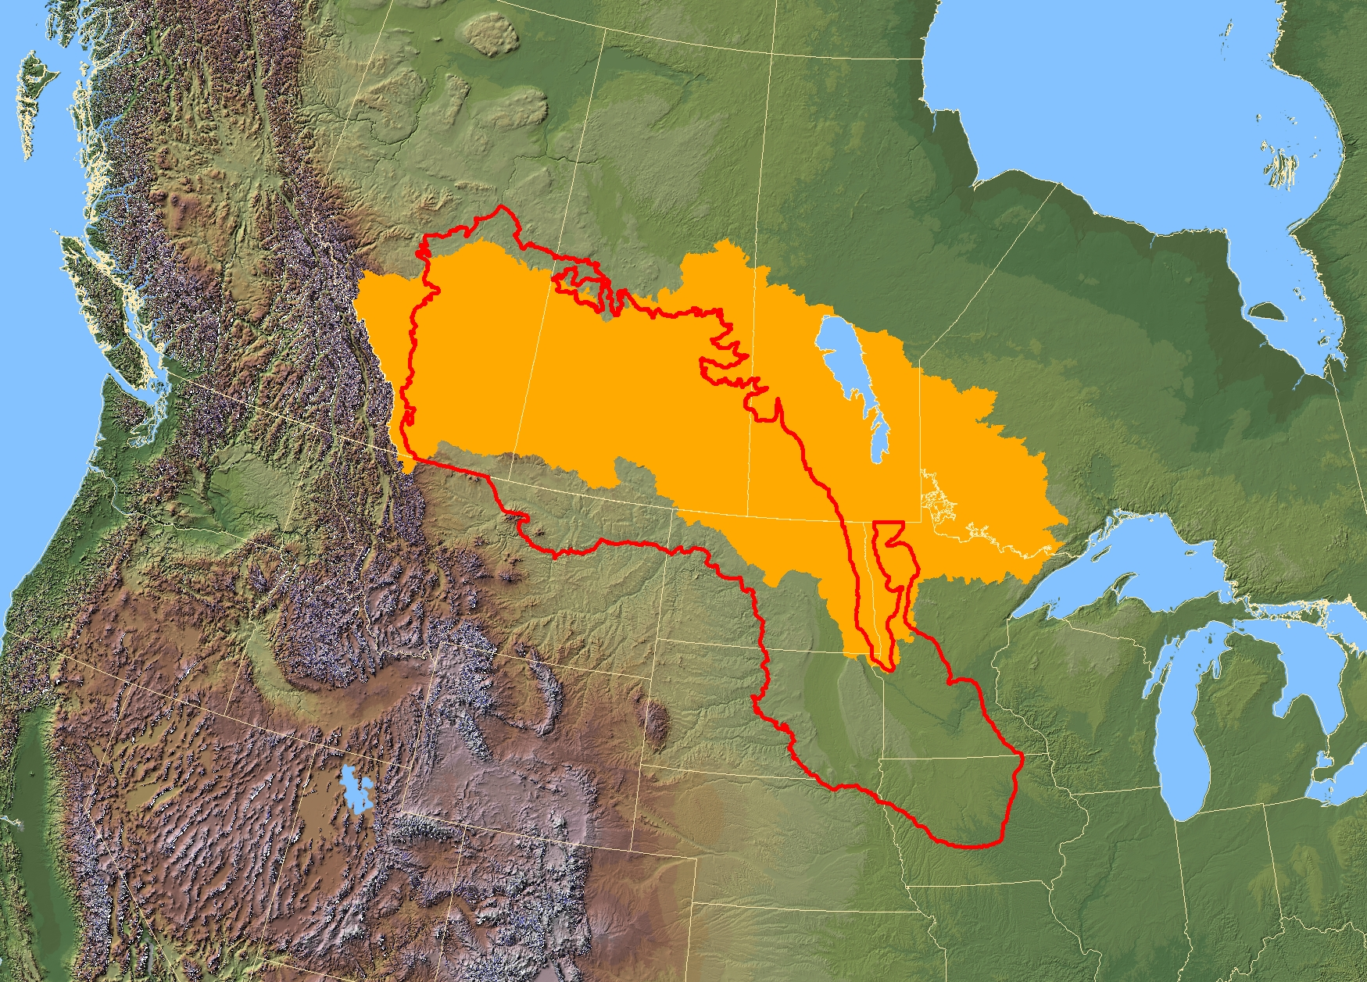


Canadian portion of the Prairie Pothole Region covers approximately 50% of the Lake Winnipeg watershed

Slide 3
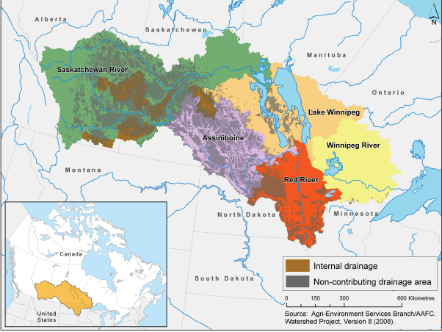
The effective drainage area is that portion of a drainage basin which might be expected to entirely contribute runoff to the main stream during a flood with a return period of two years
This definition does not account for the dynamic nature of, or changes to the connectivity of watershed contributing areas
Figure 1.1: Lake Winnipeg watershed. Internal drainage consists of closed watersheds that do not drain to Lake Winnipeg via large rivers. Non-contributing drainage areas contribute flow only under the wettest of conditions (Environment Canada and Manitoba Water Stewardship, 2011).

Slide 4
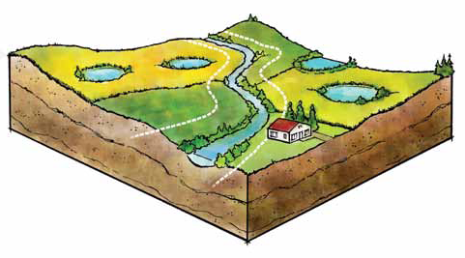
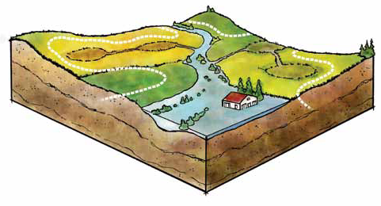
Intact wetlands
Historical Effective Drainage Area
New Effective Drainage Area as a result of wetland drainage
Drained wetlands

Slide 5
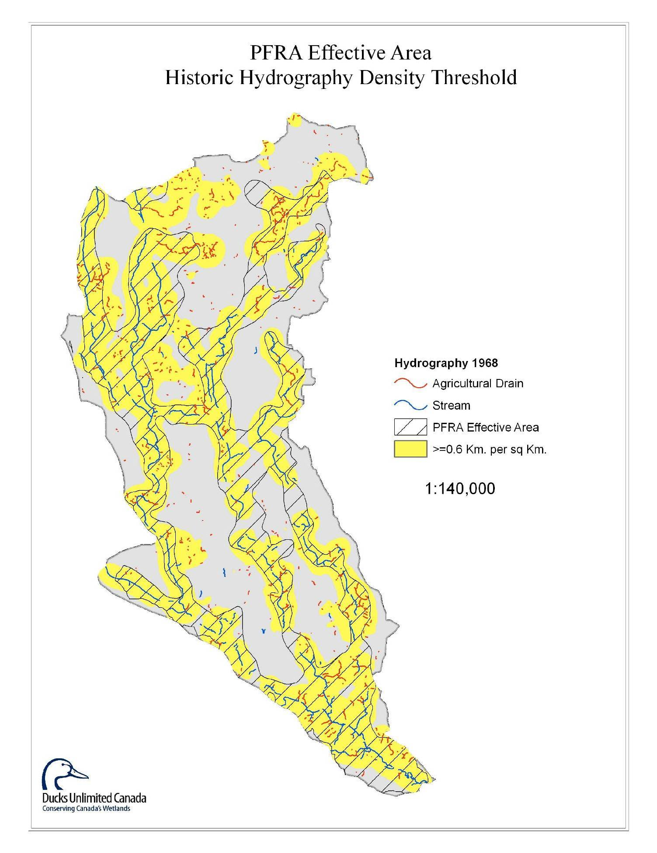
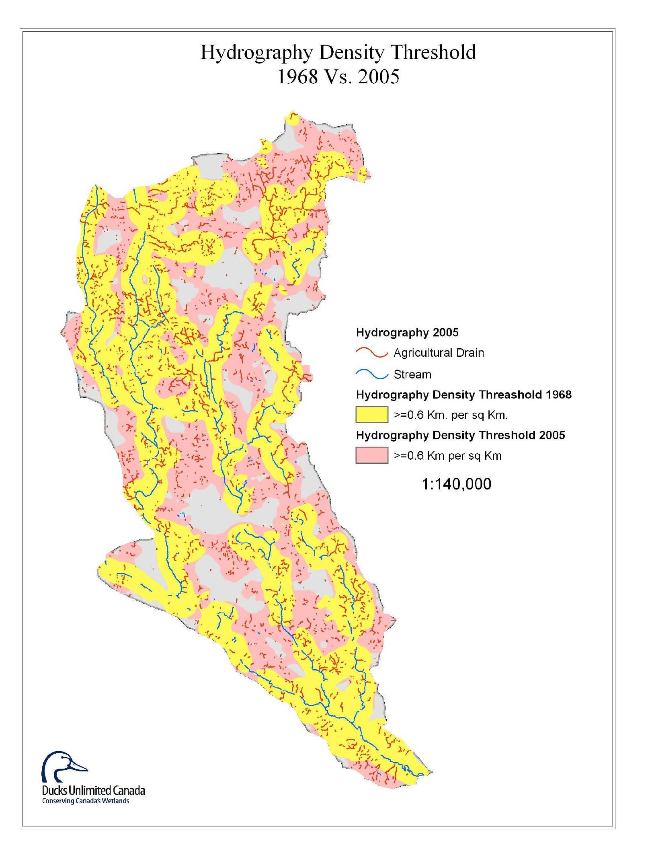
Contributing area increased from 14,668ha (1968) to 22,507ha (2005), an increase of 53.4% over the 1968 condition

Slide 6
Flood storage capacity illustration of wetland complexes under wet antecedent conditions (based on Huang et al., 2011)

Slide 7
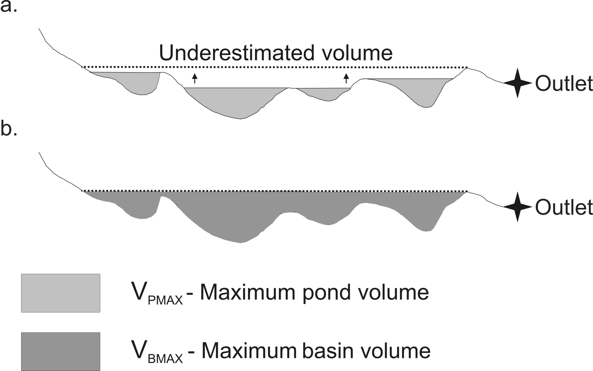
The sum of maximum pond volume (VPMAX) in the basin may not be equal to the total maximum water volume a basin can store (VBMAX). [Prairie Hydrogeomatics Ltd., 2012]

Slide 8
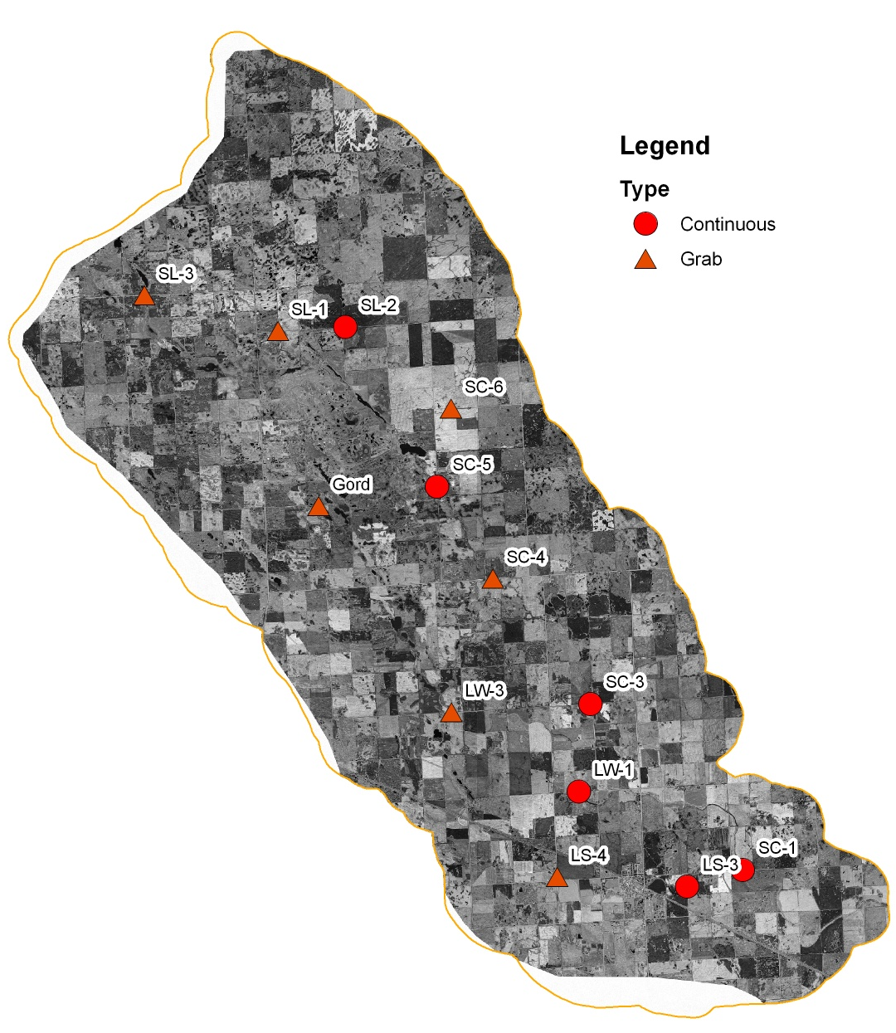
Smith Creek Research Basin Monitoring Stations
Established 10 high quality hydrological monitoring stations
  5 continous automated
  5 manual stations
Collecting detailed water chemistry from all stations throughout watershed
Collecting information on pesticides and mercury at 4 stations

Slide 9
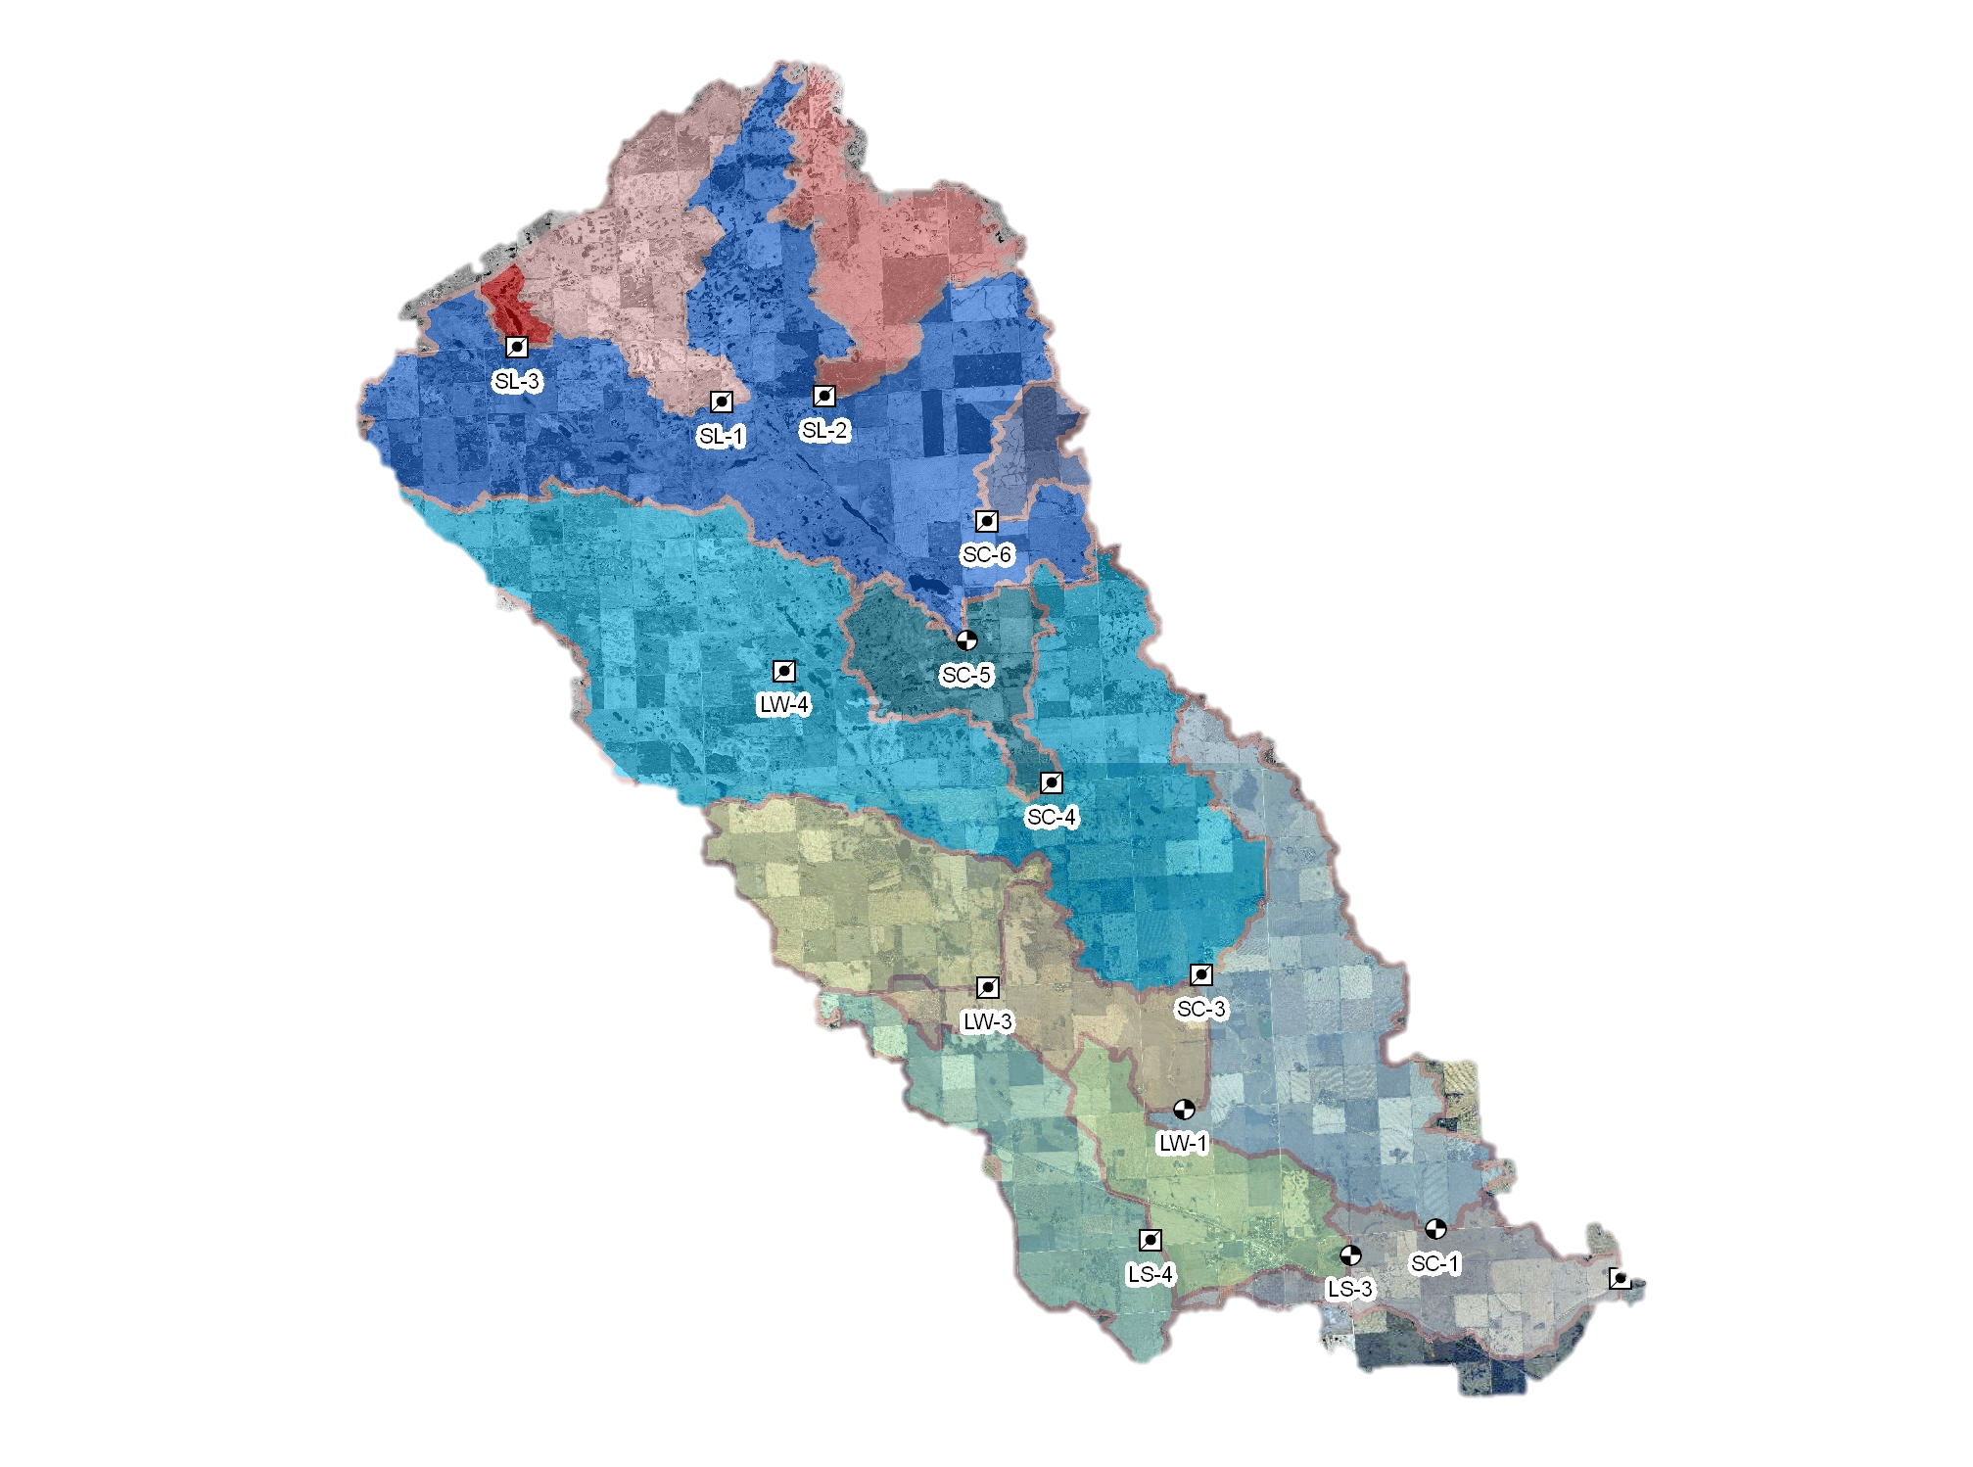

Slide 10
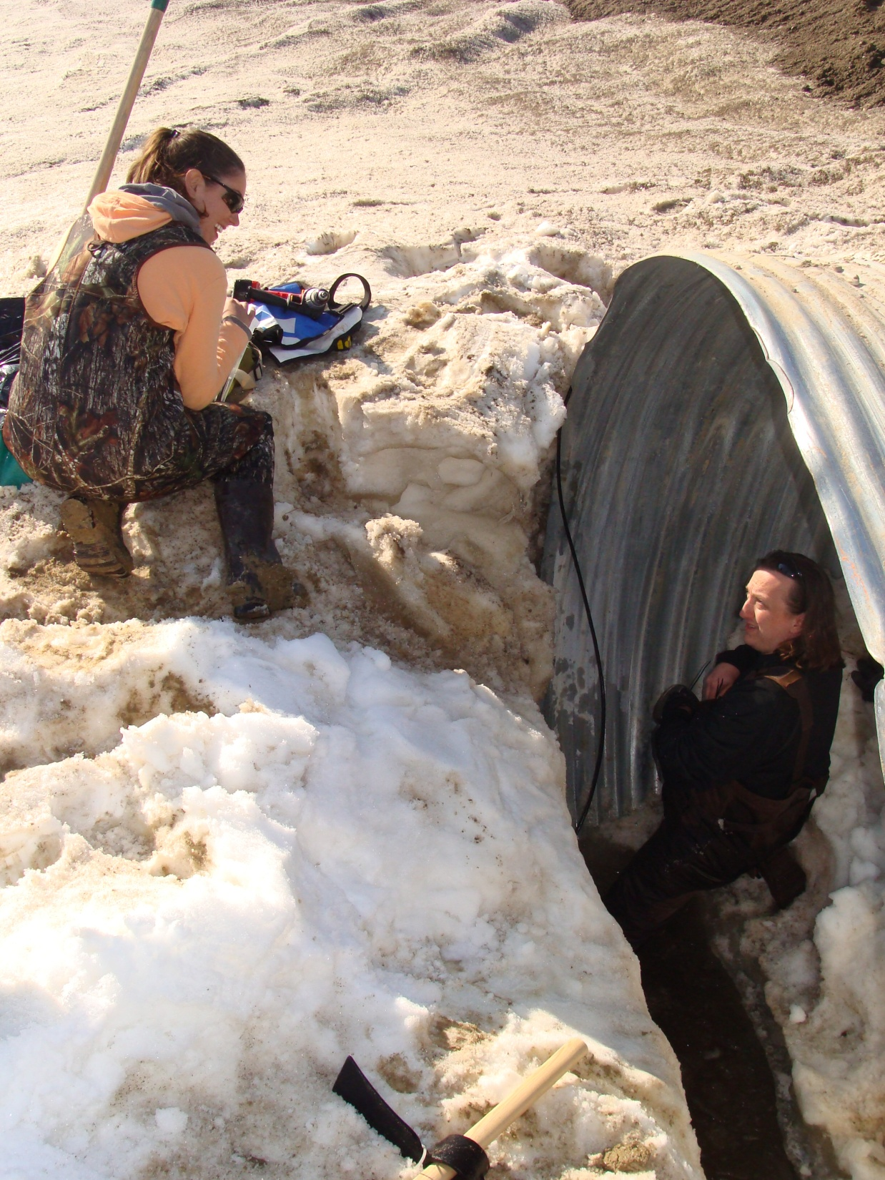
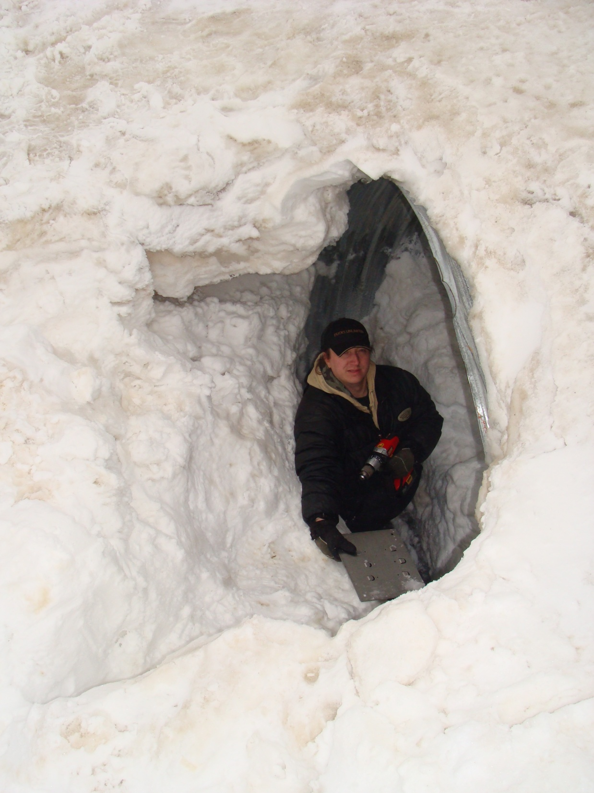

Slide 11
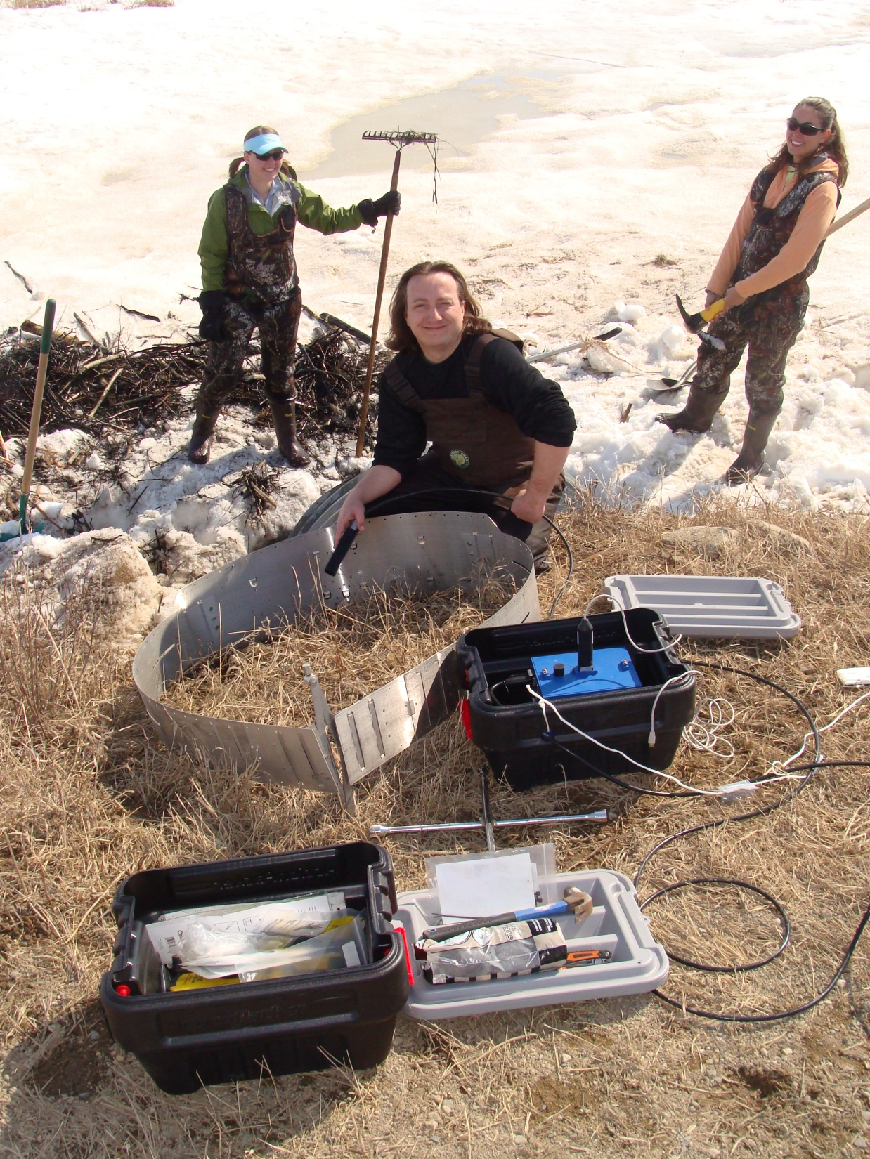
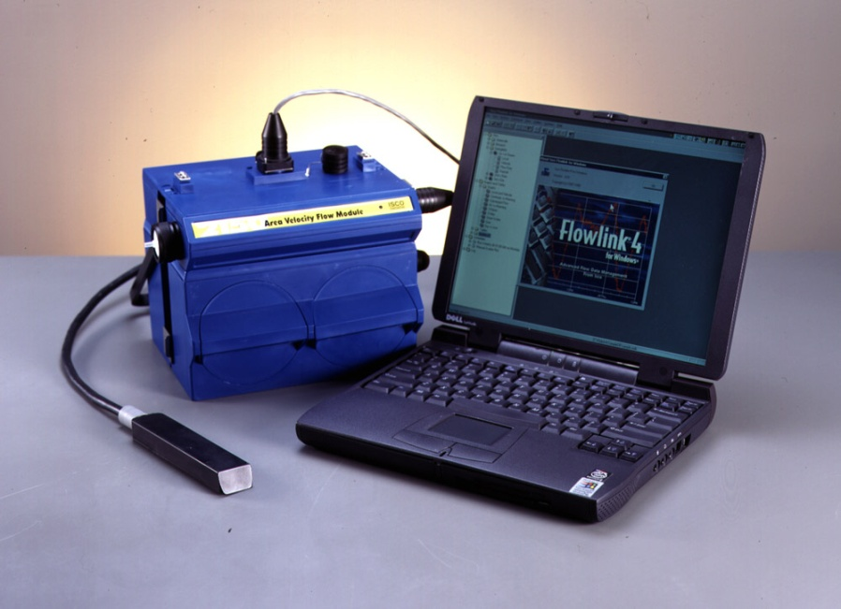
ISCO 2150 Area Velocity Module
Continuous wave Doppler flow meter for portable flow surveys and permanent installations.
Uses continuous wave Doppler technology to measure mean velocity. The sensor transmits a continuous ultrasonic wave, then measures the frequency shift of returned echoes reflected by air bubbles or particles in the flow.

Slide 12
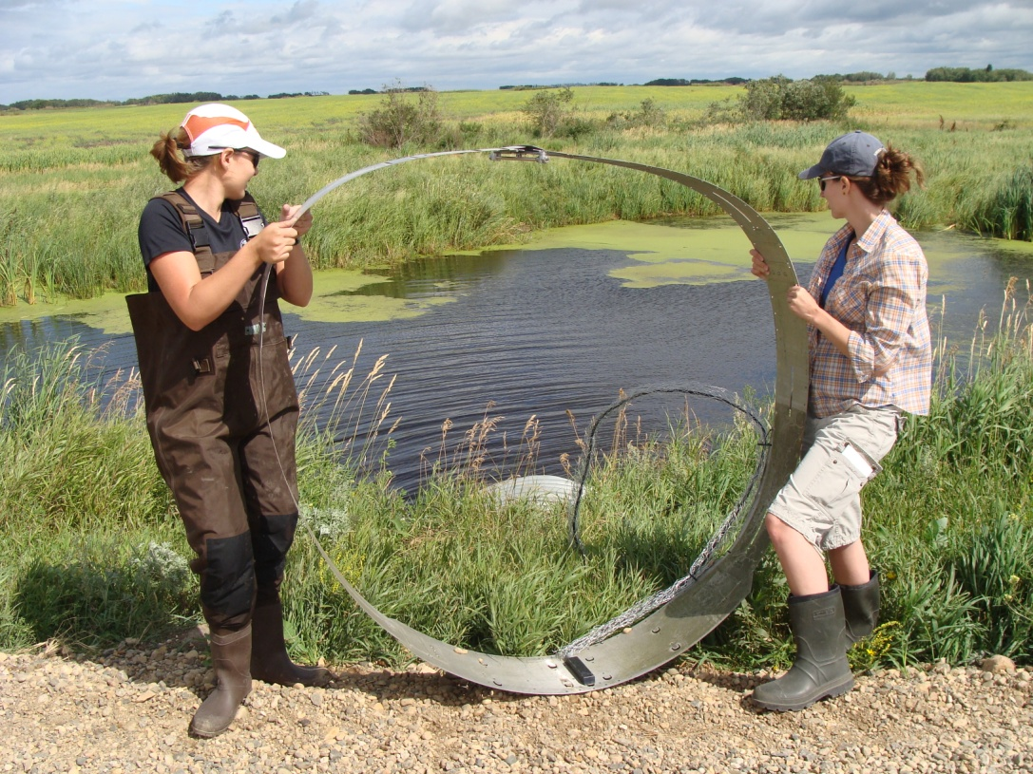
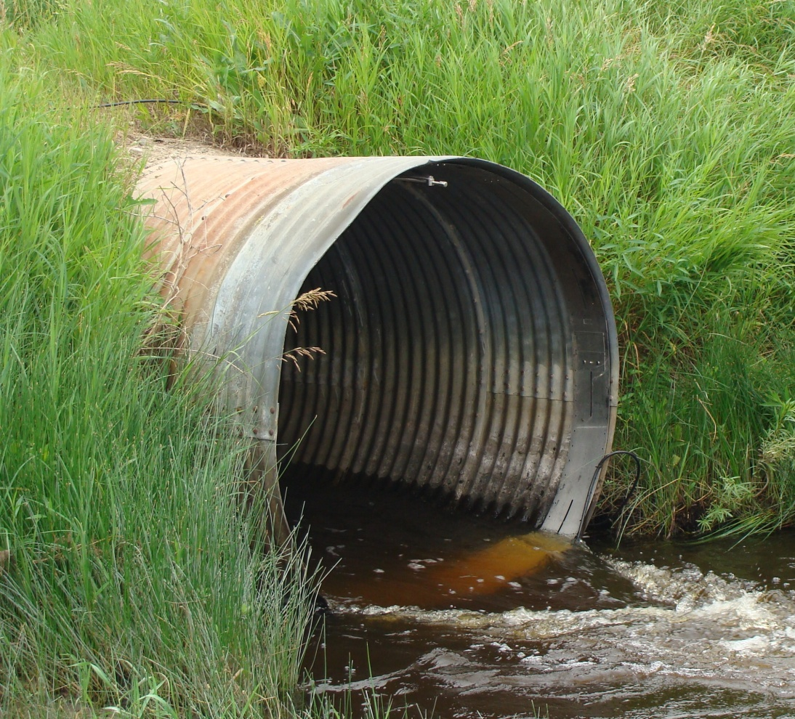
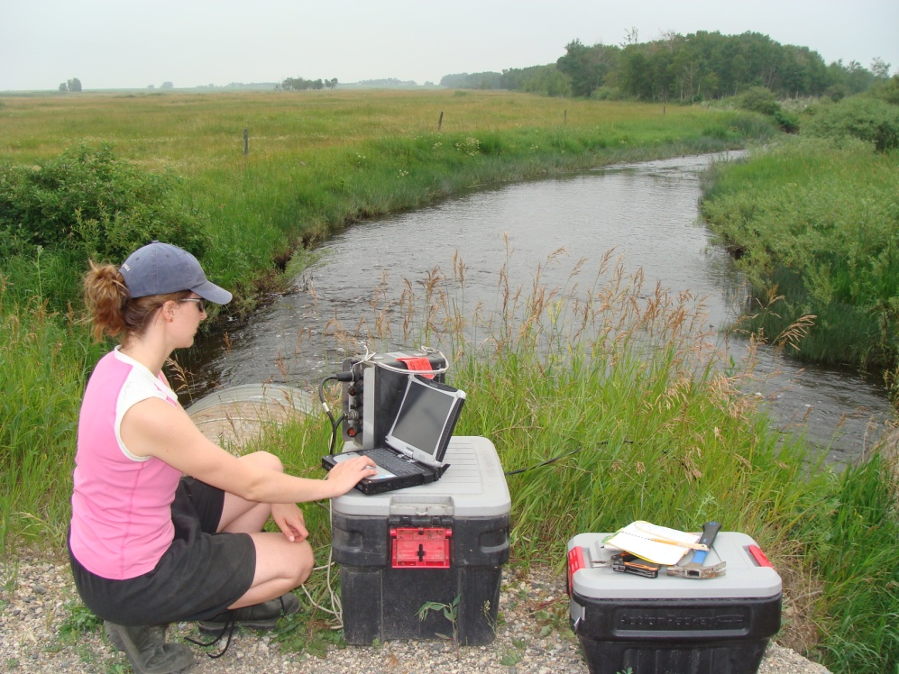

Slide 13
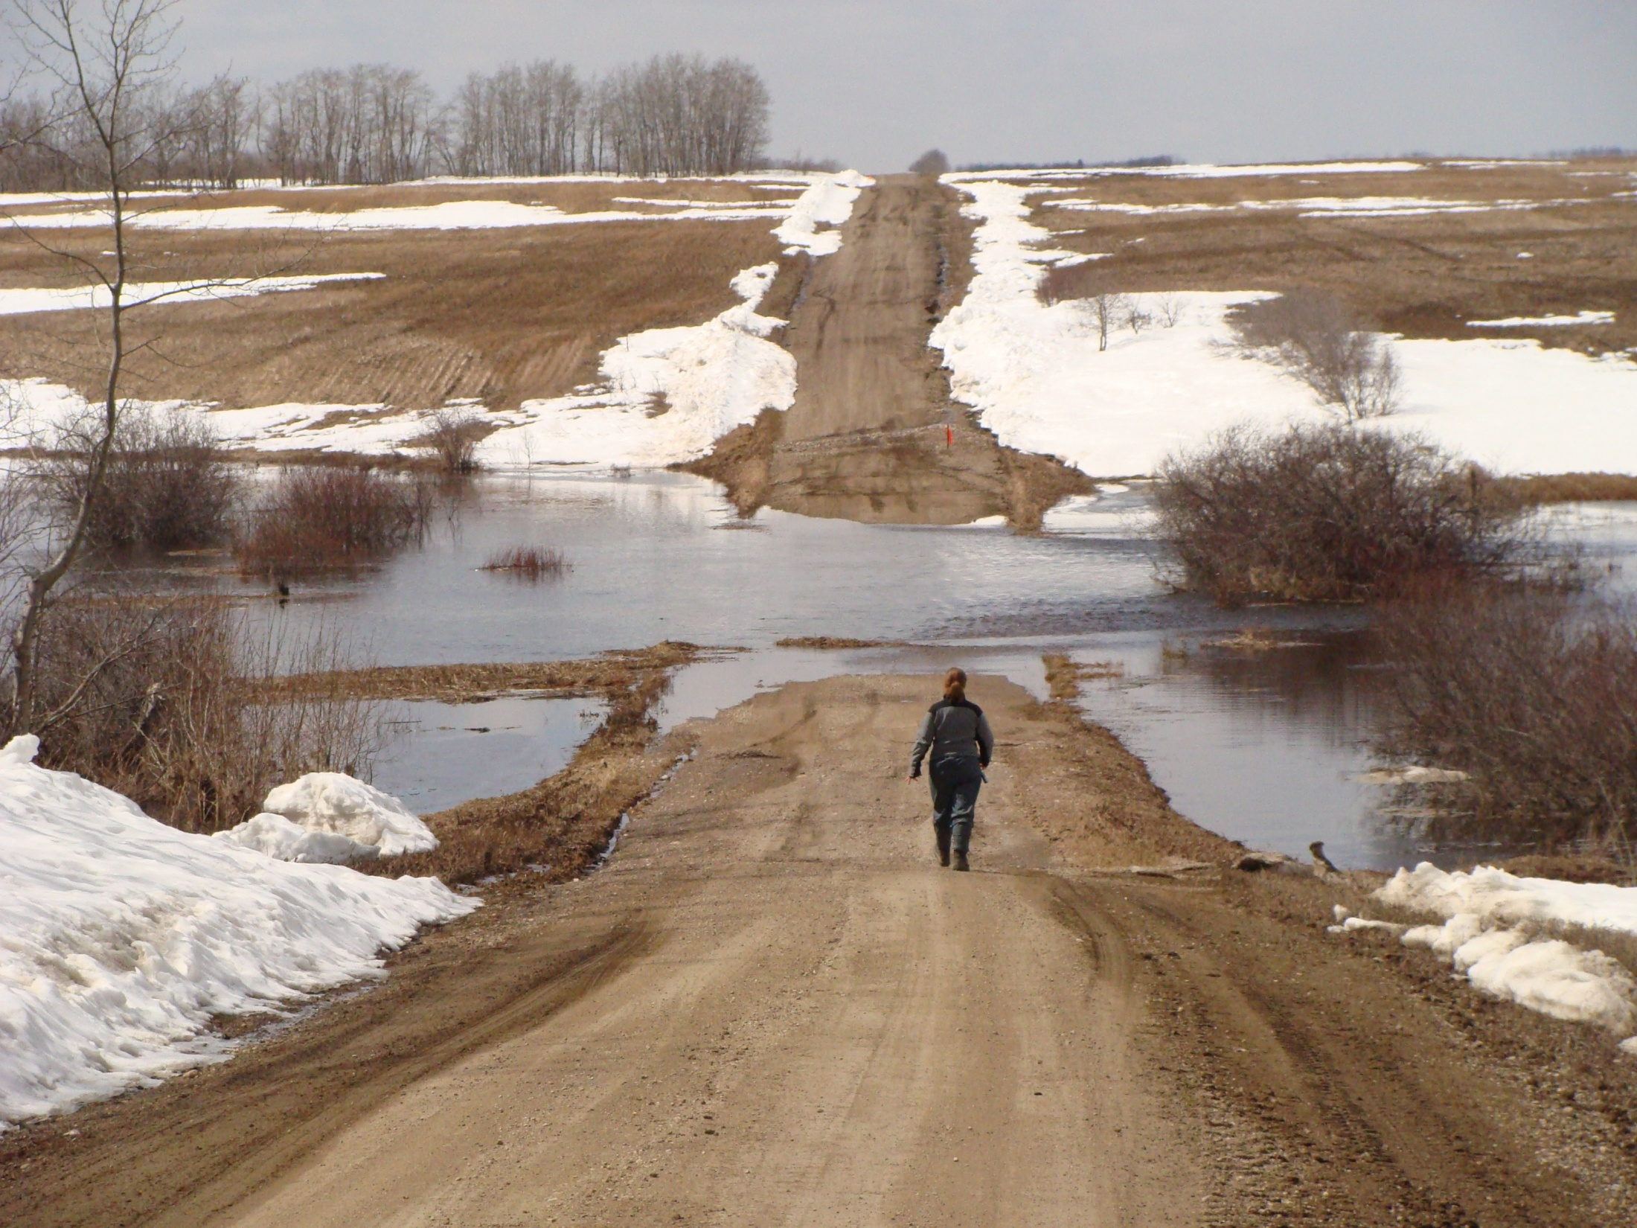

Slide 14
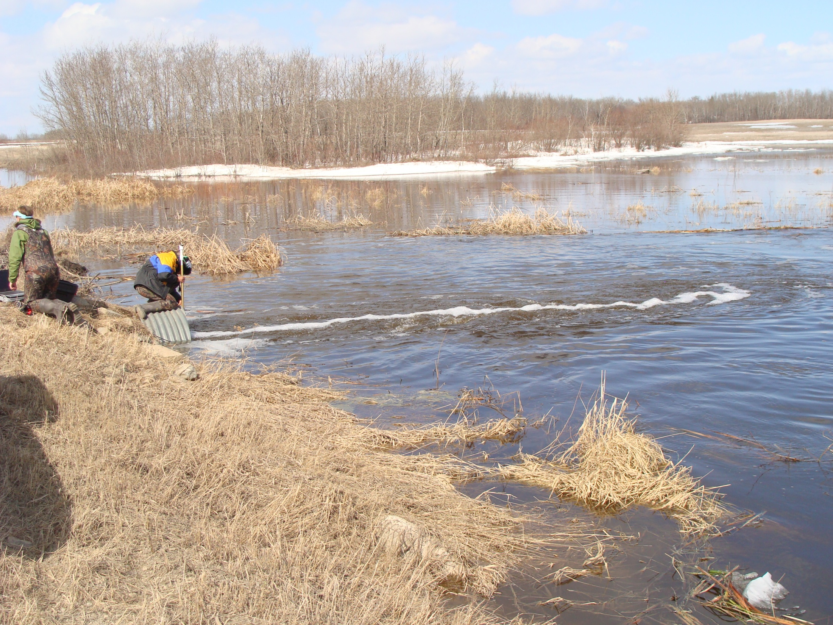

Slide 16
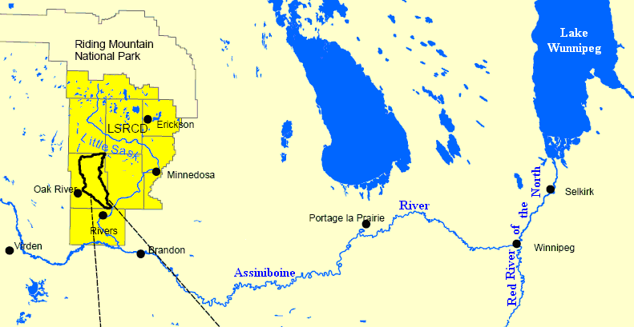
Broughton Creek Watershed
• 25,000 ha
• 74% cropland
• 11% rangeland
• 10% wetland
• 4% forest

Slide 17
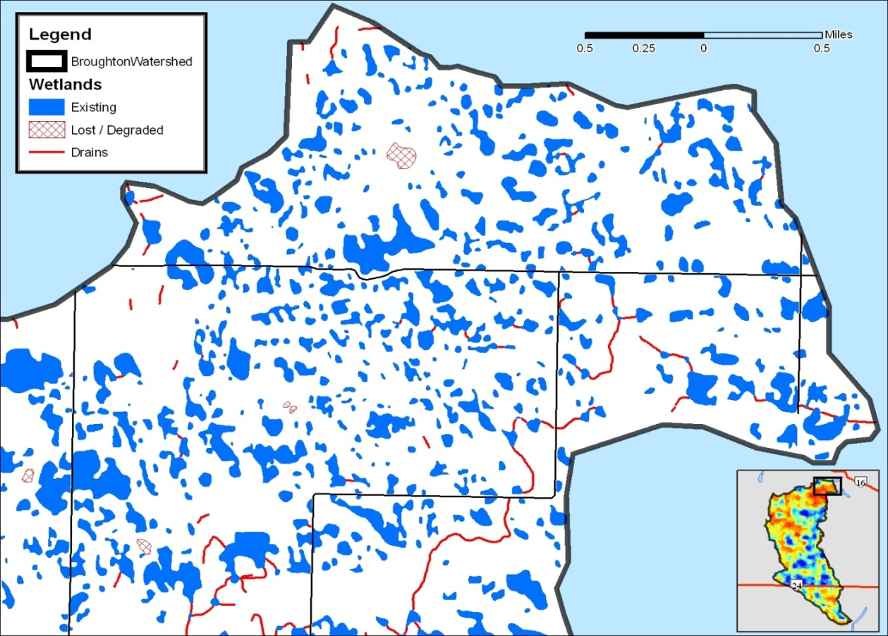
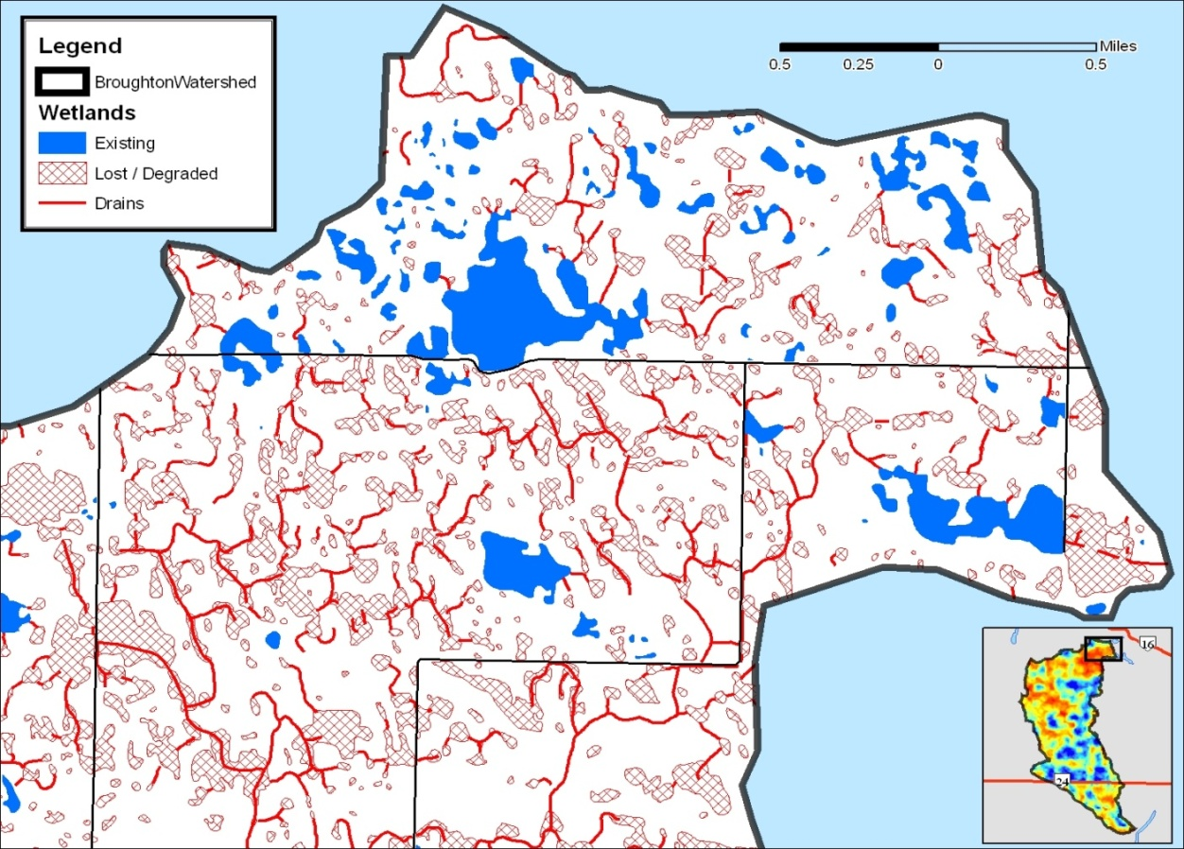
2005
1968
21% reduction
in wetland area
69% of wetland
basins have been
lost or degraded

Slide 18
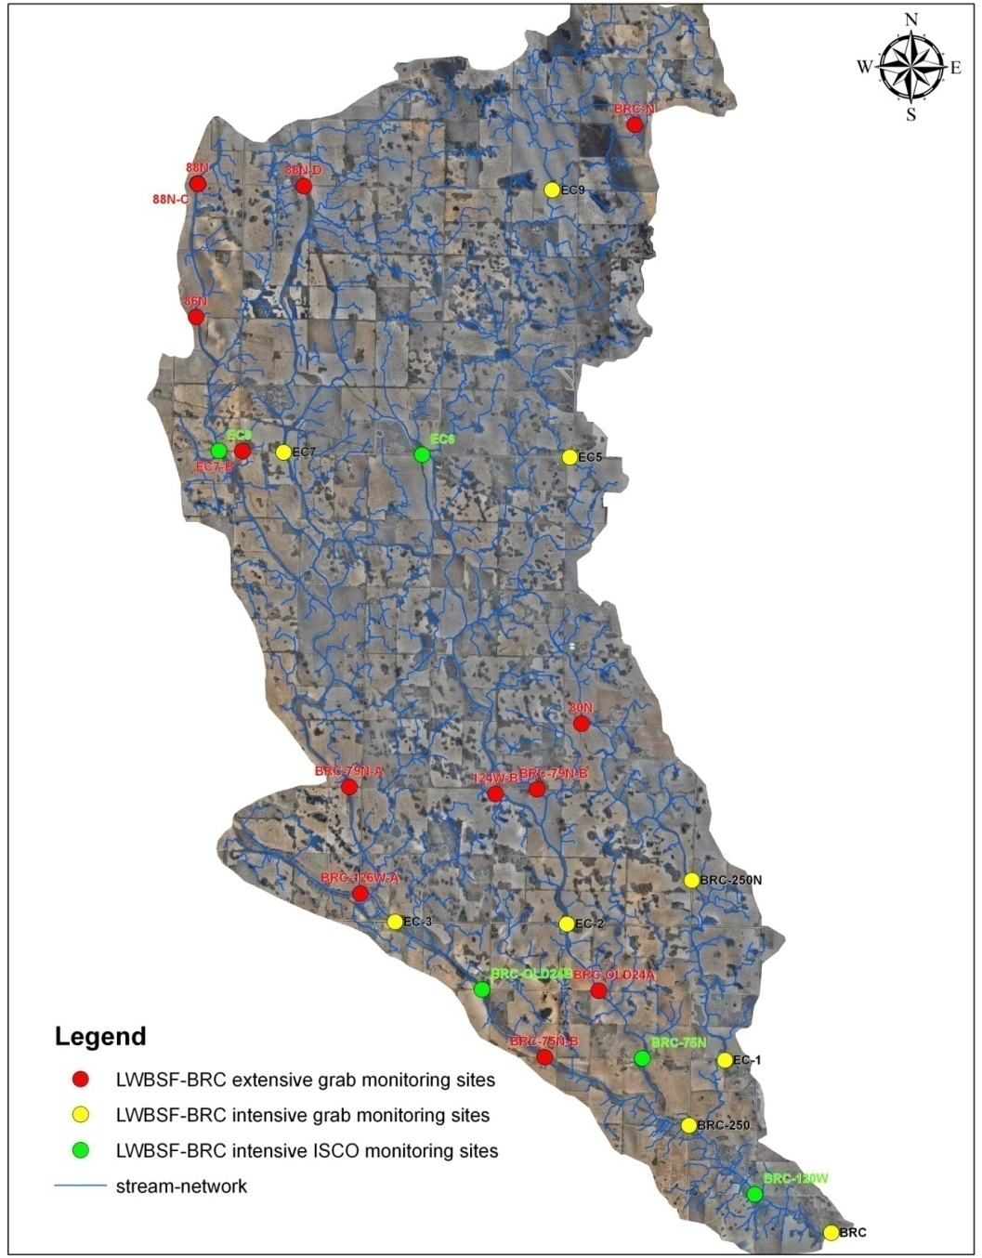
Developing Broughton’s Creek as a model / experimental watershed representative of the MB PPR
Received funding from EC to expand monitoring in BC
Collecting flow and water quality from a series of 10 stations throughout watershed
Recently flew LiDAR for entire watershed to enable accurate estimation of wetland CAs

Slide 19
Results
2009 – 21.5 tonnes of P
  Export = 0.84 kg P/ha
2010 – 5.0 tonnes of P
  Export = 0.19 kg P/ha
2011 – 29.9 tonnes of P
  Export = 1.17 kg P/ha
Majority of P is dissolved
Majority of discharge associated with snow melt

Slide 20
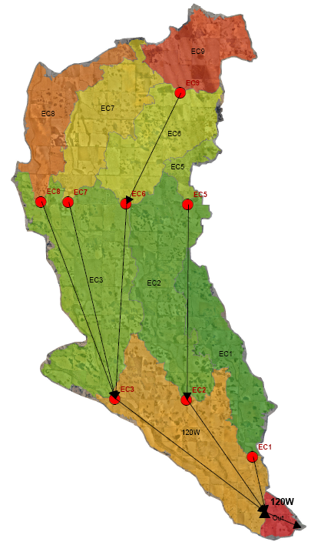
Combining Wetland and Drainage Metrics with Flow and Water Quality

Slide 21
Combining Wetland and Drainage Metrics with Flow and Water Quality
As wetland drainage increases, runoff increases regardless of event size
This demonstrates the need to account for wetland drainage, storage, as well as changes to contributing area
Similar research by Huang et al. (2011) demonstrated that PPR wetlands in ND had the ability to prevent runoff during a 200 mm equivalence snow melt
2011 – larger spring runoff driven by snow
+ high antecedent moisture conditions
2009 – large spring runoff driven by snow
2010 – little snow, large summer rains

Slide 22
Combining Wetland and Drainage Metrics with Flow and Water Quality
More drained wetland greater water yield.
Greater water yield, greater P export
Therefore wetland drainage increases P export at the watershed scale

Slide 23
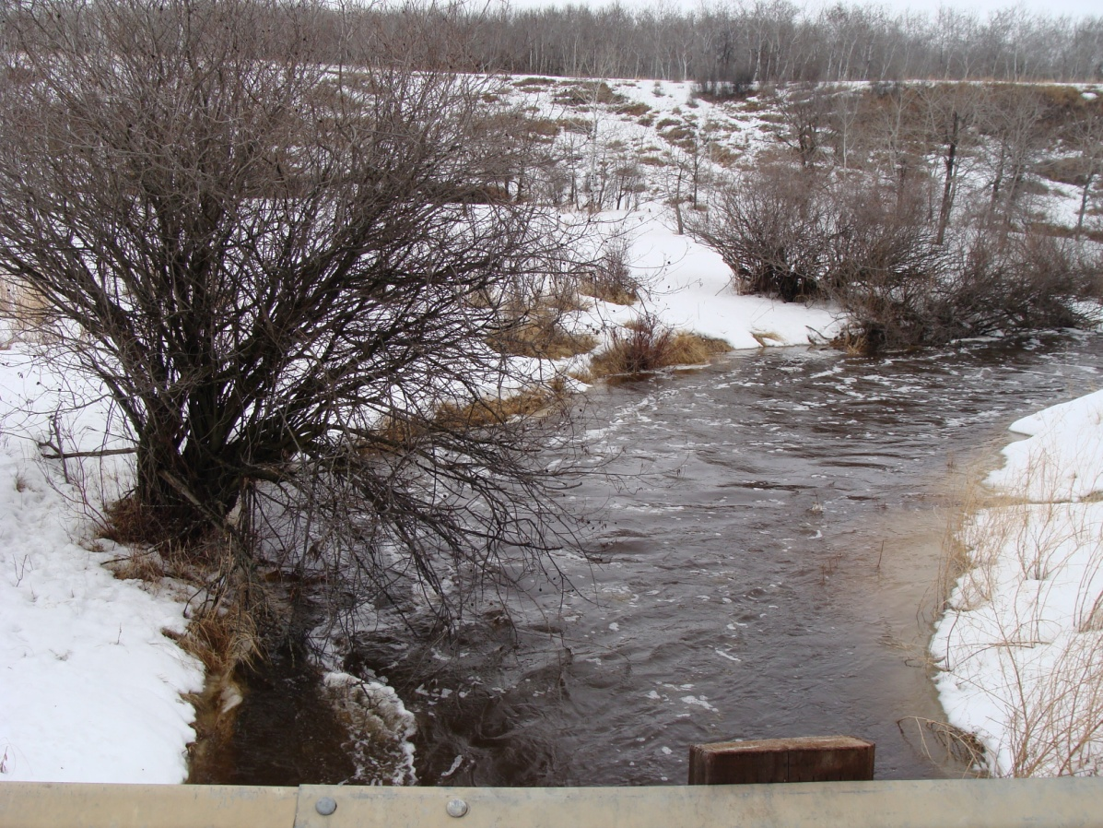
Conclusions
Wetland loss has had a dramatic effect on water quality and quantity across the Canadian prairie
If wetland loss is allowed to continue, past, current, and future investments in expensive infrastructure such as water treatment facilities and additional flood mitigation will become increasingly less efficient

Slide 24
Final Thoughts
“It is important to note that water from drained wetlands is that part of runoff that man can control”, and “even a small reduction in flooding can result in substantial social and economic benefits.”
Cernohous (1979) The Role of Wetlands in Providing Flood Control Benefits.

